Slide 1
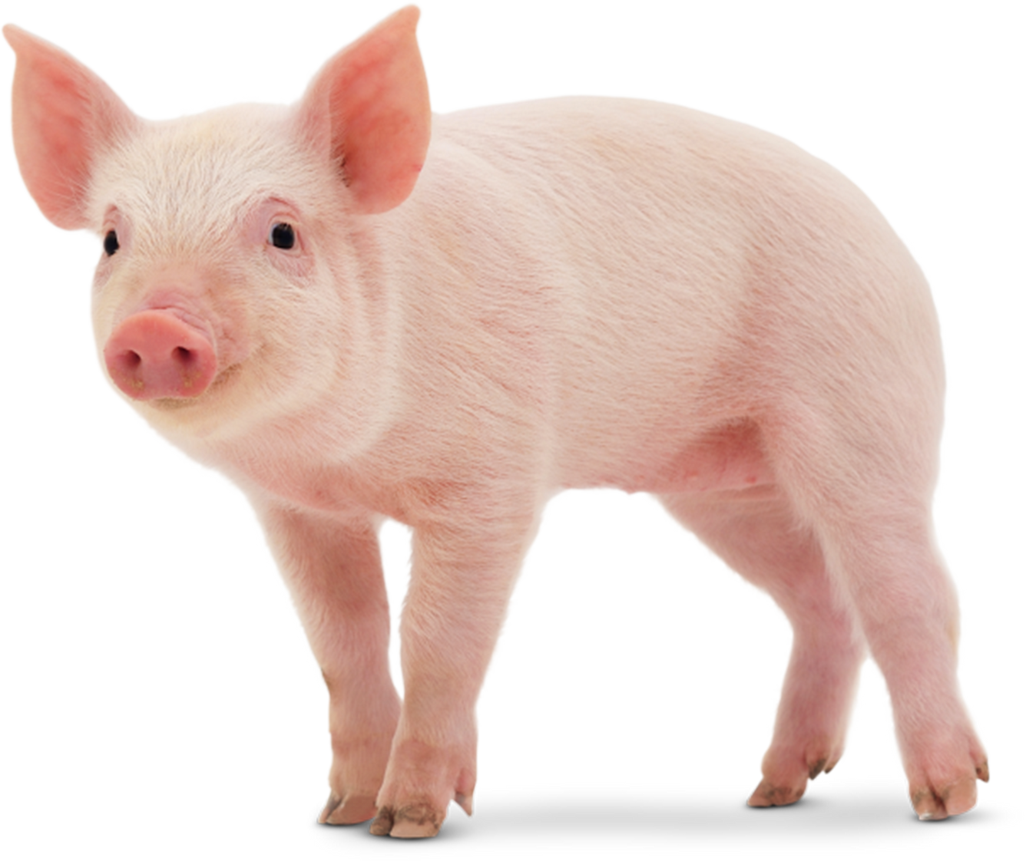
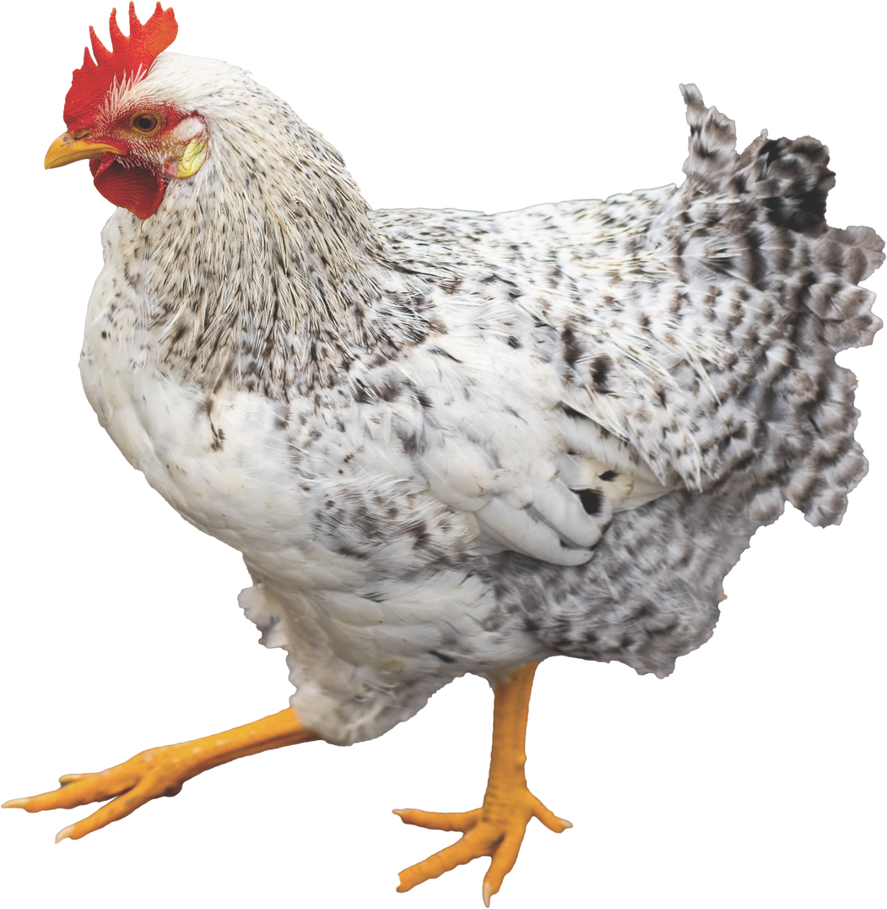
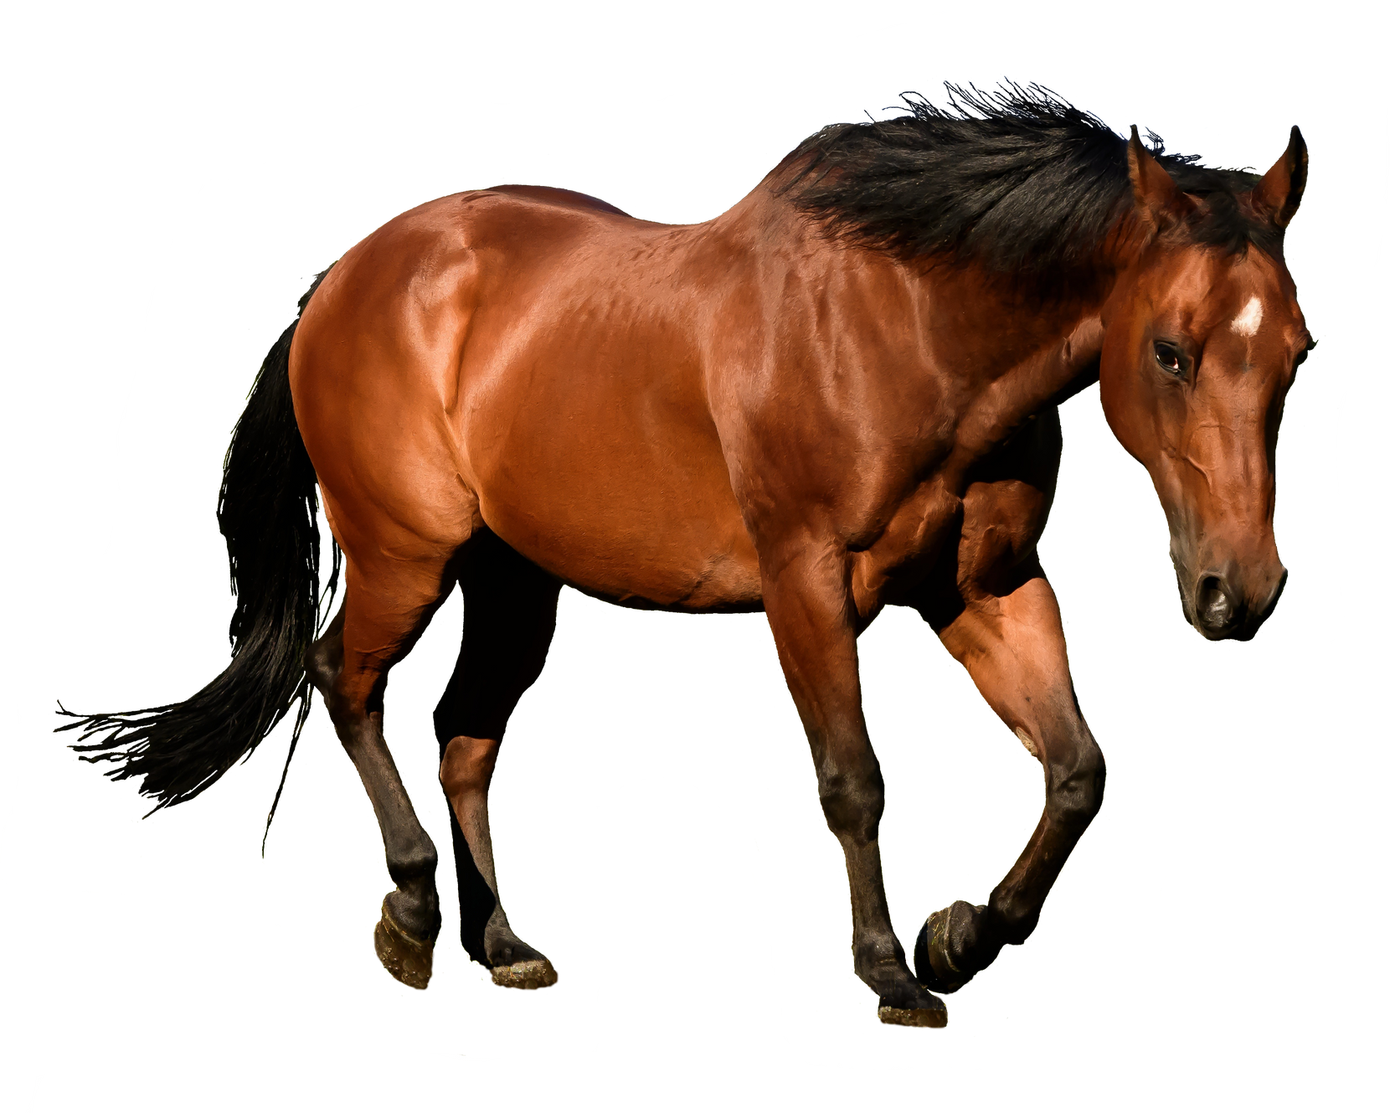
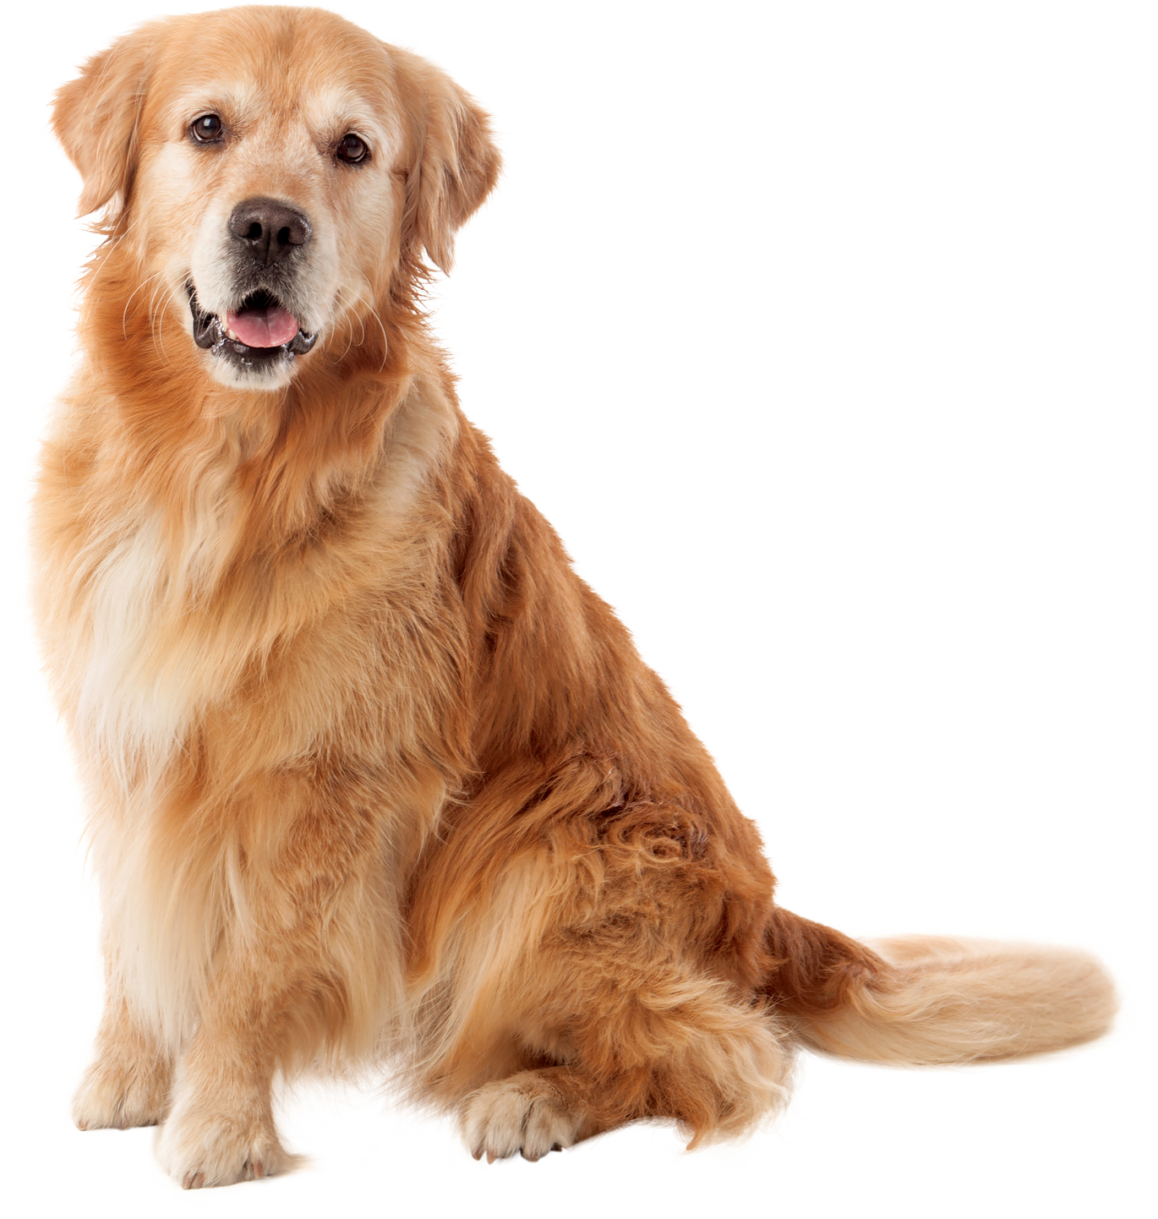
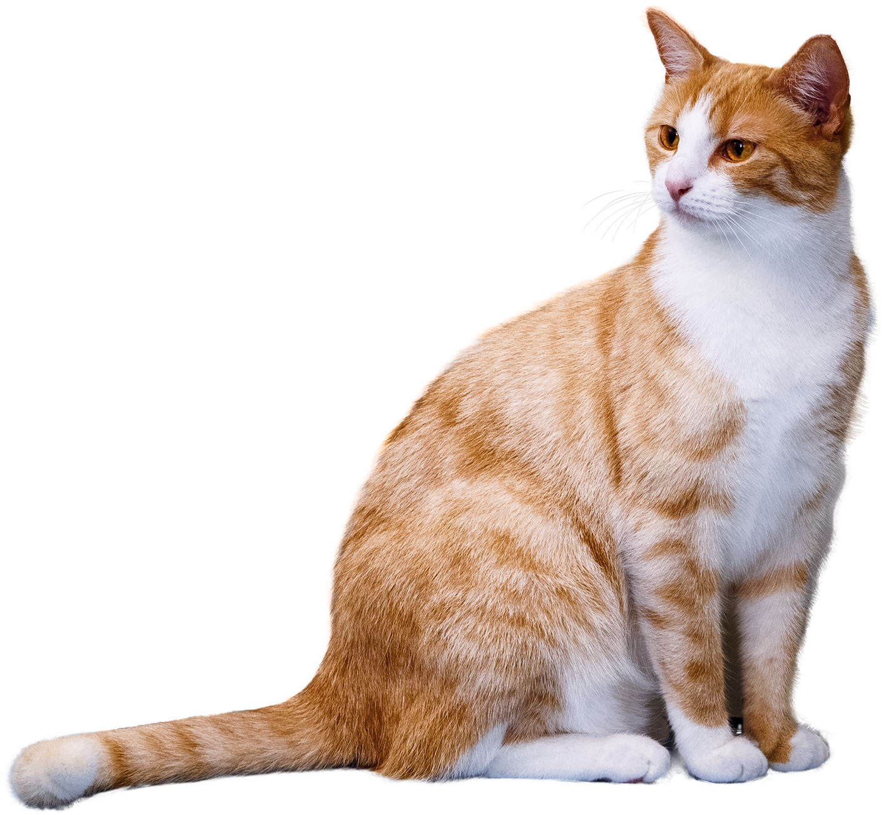
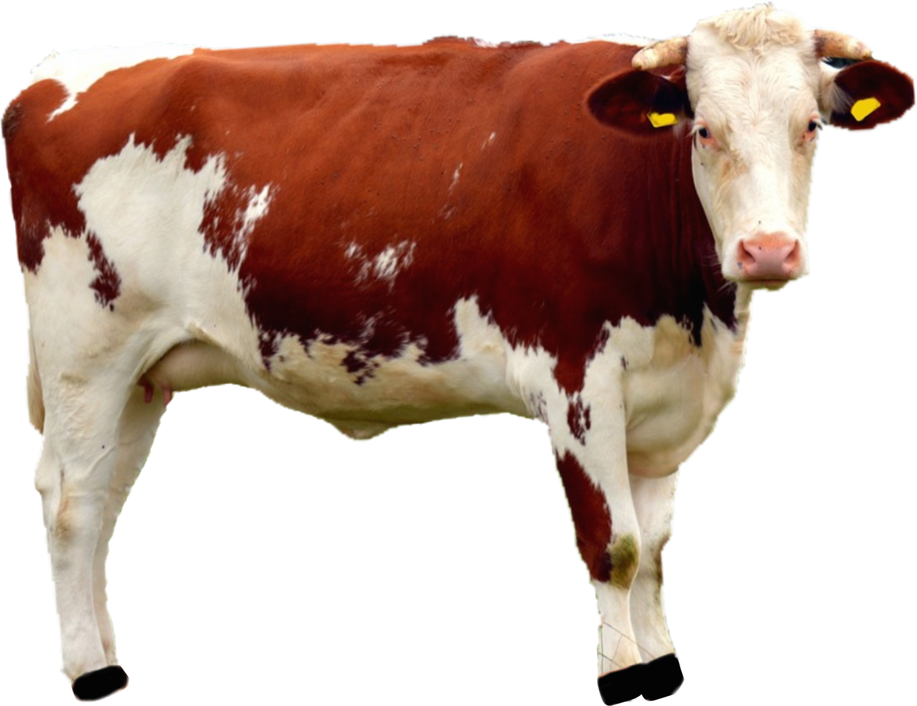
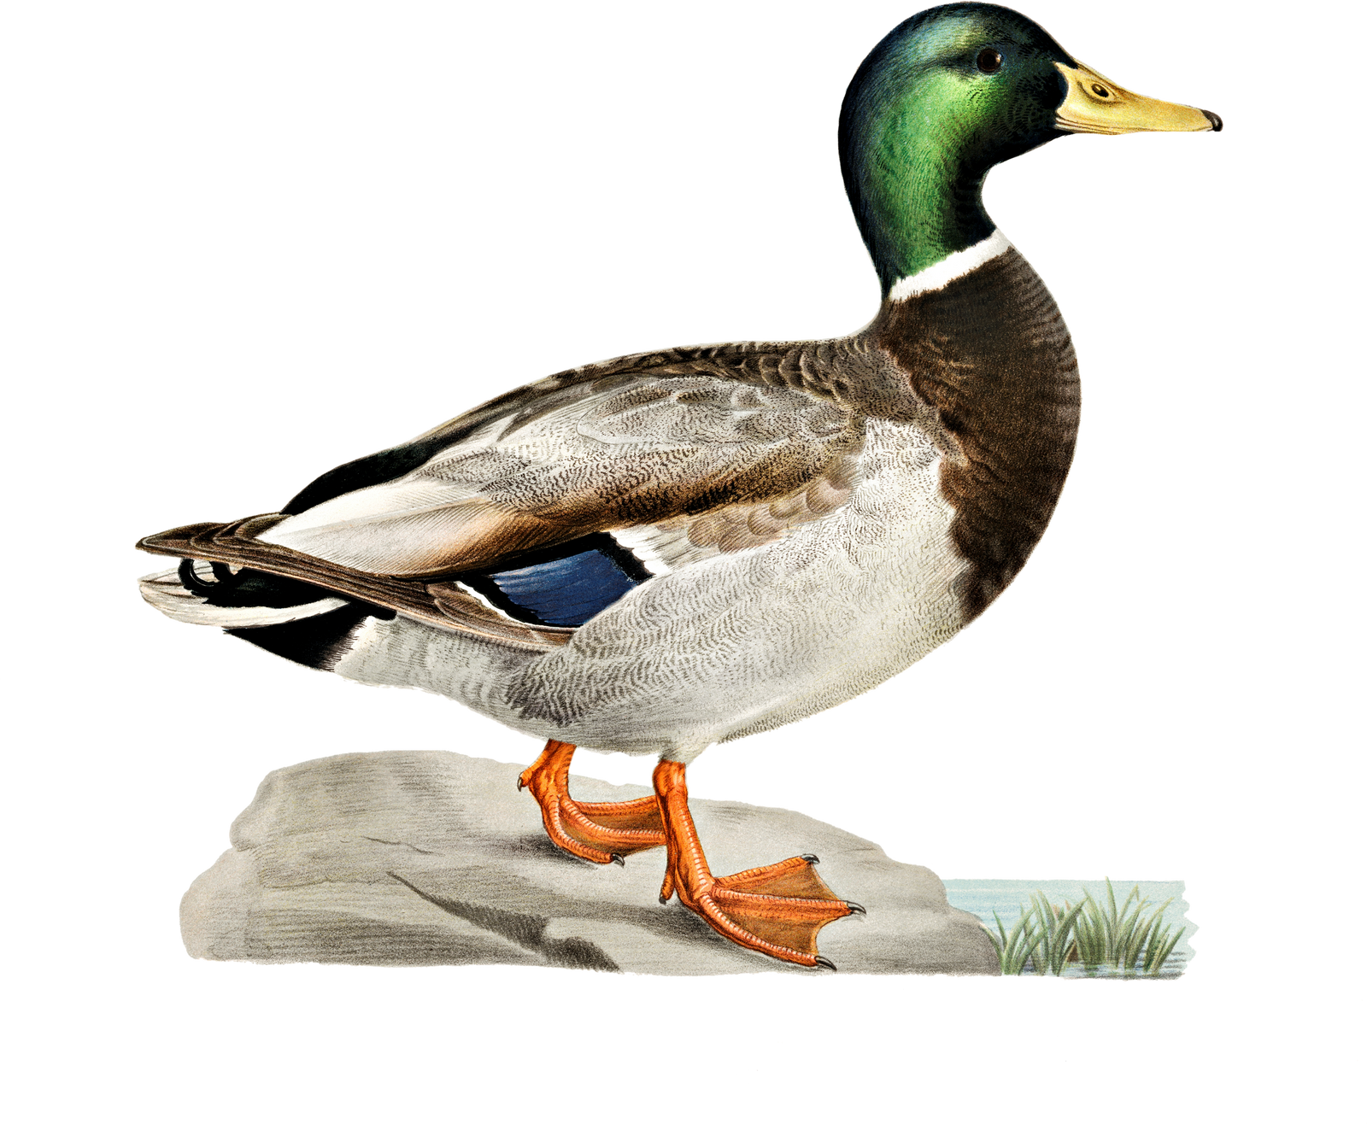
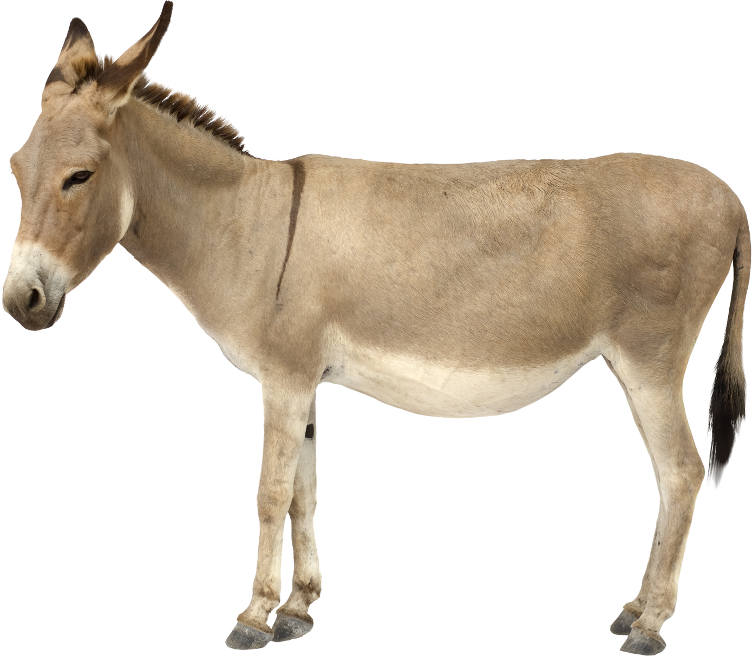
Tiere
Animals

Slide 2
der Hund
dog

Slide 3
die Katze
cat

Slide 4
das Huhn
hen

Slide 5
die Ente
duck

Slide 6
das Pferd
horse

Slide 7
das Schwein
pig

Slide 8
der Esel
donkey

Slide 9
die Kuh
cow

Slide 10
Old McDonald had a farm
Old McDonald had a farm he ha he ha ho.
And on that farm he had a cow he ha he ha ho.
With a moo moo here and a moo moo there
here a moo there a moo
everywhere a moo moo.
Old McDonald had a farm he he he ha ho.

Slide 11
Fragen
Questions
Wie heiẞt das Tier?
What animal is it?
Wie macht das Tier?
What sound does the animal make?
Was frisst das Tier?
What does the animal eat?
Wo wohnt das Tier?
Where does the animal live?
Wie wohnt das Tier?
How does the animal live?
Wie sieht das Tier aus?
What does the animal look like?

